Slide 1
Parallelism
Concepts
Finding the Parallelism
Slides adapted from Prof. Barbara Chapman

Slide 2
Parallel Computing
Using more than one computer, or a computer with more than one processor, to solve a problem.
Motives
Usually faster computation - very simple idea - that n computers operating simultaneously can achieve the result n times faster - it will not be n times faster for various reasons.
Other motives include: fault tolerance, larger amount of memory available, ...
1.<number>

Slide 3
Background
Parallel computers - computers with more than one processor - and their programming - parallel programming - has been around for more than 40 years.
1.<number>

Slide 4
Gill writes in 1958:
“... There is therefore nothing new in the idea of parallel programming, but its application to computers. The author cannot believe that there will be any insuperable difficulty in extending it to computers. It is not to be expected that the necessary programming techniques will be worked out overnight. Much experimenting remains to be done. After all, the techniques that are commonly used in programming today were only won at the cost of considerable toil several years ago. In fact the advent of parallel programming may do something to revive the pioneering spirit in programming which seems at the present to be degenerating into a rather dull and routine occupation ...”
Gill, S. (1958), “Parallel Programming,” The Computer Journal, vol. 1, April, pp. 2-10.
1.<number>

Slide 5
Speedup Factor
Execution time using one processor (best sequential algorithm)
t_{s}
S(p) =
t_{p}
Execution time using a multiprocessor with p processors
where t_{s} is execution time on a single processor and t_{p} is execution time on a multiprocessor.
S(p) gives increase in speed by using multiprocessor.
Use best sequential algorithm with single processor system. Underlying algorithm for parallel implementation might be (and is usually) different.
1.<number>

Slide 6
Speedup factor can also be cast in terms of computational steps:
Can also extend time complexity to parallel computations.
Number of computational steps using one processor
S(p) =
Number of parallel computational steps with p processors
1.<number>

Slide 7
Maximum Speedup
Maximum speedup is usually p with p processors (linear speedup).
Possible to get superlinear speedup (greater than p) but usually a specific reason such as:
Extra memory in multiprocessor system
Nondeterministic algorithm
1.<number>

Slide 8
Maximum Speedup
Amdahl’s law
t
s
ft
s
(1
-
f
)
t
s
Serial section
Parallelizable sections
(a) One processor
(b) Multiple
processors
p
processors
t
(1
-
f
)
t
s
/
p
1.<number>
p

Slide 9
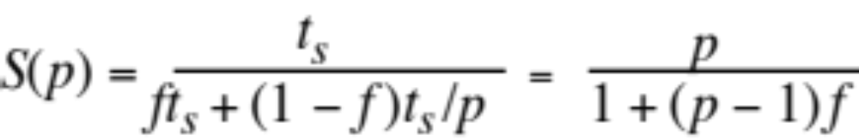
Speedup factor is given by:
This equation is known as Amdahl’s law
1.<number>

Slide 10

Speedup against number of processors
20
f
= 0%
16
12
f
= 5%
8
f
= 10%
4
f
= 20%
4
8
12
16
20
Number of processors
,
p
1.<number>

Slide 11
Even with infinite number of processors, maximum speedup limited to 1/f.
Example
With only 5% of computation being serial, maximum speedup is 20, irrespective of number of processors.
1.<number>

Slide 12
Superlinear Speedup example - Searching
(a) Searching each sub-space sequentially
Start
Time
t
s
t
s
/p
Sub-space
Δ
t
search
x
t
s
/p
Solution found
x
indeterminate
1.<number>

Slide 13
(b) Searching each sub-space in parallel
Δ
t
Solution found
1.<number>

Slide 14
Speed-up then given by
t
x
×
s
+
Δ
t
p
S(p)
=
Δ
t
1.<number>

Slide 15
Worst case for sequential search when solution found in last sub-space search. Then parallel version offers greatest benefit, i.e.
p
–
1
×
t
+
Δ
t
s
p
S(p)
=
→
∞
Δ
t
as
Δ
t tends to zero
1.<number>

Slide 16
Least advantage for parallel version when solution found in first sub-space search of the sequential search, i.e.
Actual speed-up depends upon which subspace holds solution but could be extremely large.
Δ
t
S(p) =
= 1
Δ
t
1.<number>

Slide 17

First we discuss some fundamental ideas of shared memory programming.
We return to these in more detail later.

Slide 18
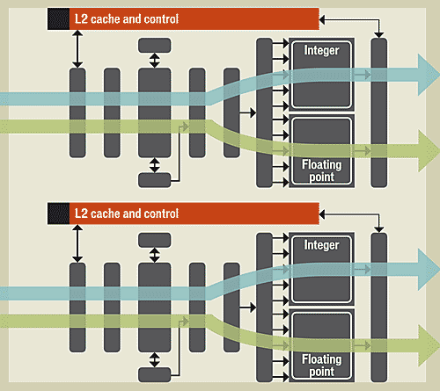
What are Threads?
Hardware level: a set of resources capable of supporting execution of an instruction stream
Software: an independent stream of instructions
Software threads mapped to hardware

Slide 19
What are Threads?
Some confusion on this point
In the past, threads most often an OS concept
Different kinds of actions started and run independently (no interactions, no ordering)
  No hardware concurrency
  Time-slicing
  So only appeared to be working simultaneously
So led people to not clearly distinguish from processes
Light-weight processes

Slide 20
Processes and Threads
Process is created to execute a program
  Executes independently
  Assigned pages in memory
  May have one or more threads (starts with one)
Message-passing programs: independent processes send messages to each other
Shared memory programs; several threads in same process share the same memory

Slide 21
What are Threads?
We usually think of threads as independent “threads of control” in application
We’ll need to know how they are executed
A thread needs:
  Program code, program counter, call stack
  Small amount of data of its own

Slide 22
Where Do Threads Execute?
Core 1
Core 2
Hardware runs one or more instruction streams per core
Threads programmed by application developer (or by compiler) are mapped to hardware
Sometimes an application thread gets moved around in hardware
Threads in the same core may share most resources
Registers
Registers
L1 Dcache
L1 Dcache
Small, 4MB
Very small
L2 cache
DDR2 RAM

Slide 23
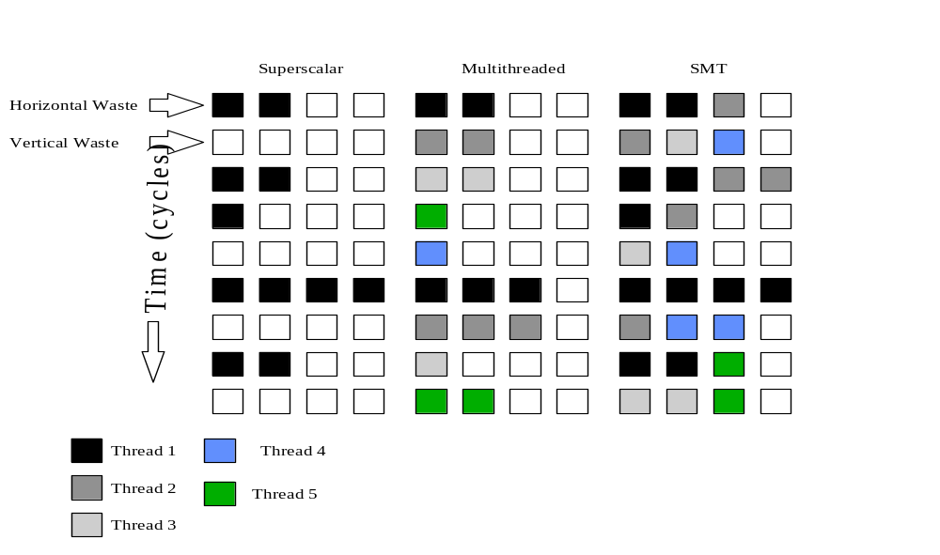
Superscalar, Multithreading and SMT (Hyperthreading)
There are even reconfigurable machines (that may assign functional units to a specific thread)

Slide 24
Parallel Software
Different parts of a program execute concurrently on different processors (cores, hardware threads) of a parallel computer
Goal: shorten execution time or process more data in same time
Starting point is often a sequential program
Approach depends on target architecture
Sometimes a parallel application is written from scratch.

Slide 25
Parallelism in Software
In shared memory model, threads read and write same memory
  Threads share the address space
  But they might also have some data of their own
In distributed memory model, processes read and write distinct memories
  Remember, processes each have their own address space

Slide 26
Parallelism in Software
Threads/processes realizing parallel program execute concurrently
  Each will execute part of the program
An individual thread is sequential
An individual process may contain multiple threads
Usually one thread per execution resource
  But there are other models
Interesting (sometimes important) question: what happens if my multithreaded program is executed on a strictly sequential computer?

Slide 27
Parallelism in Software
Code 1
Program is decomposed into pieces of code
Sequential pieces
(But they might create other pieces)
Threads are started, code is assigned to them
These threads are mapped to hardware
  By user or system
Code 2
Code 3
Code 6
Code 4
Code 7
Code 5

Slide 28
Parallelism in Software
Code 1
The code pieces can be executed concurrently
  At the same time
  On different resources
But some will need to interact
  Do this by inserting synchronization
  To make one thread wait for another
  Or to ensure that two different threads do not try to access the same memory location at the same time
Code 2
Code 3
Code 7
Code 4
Code 6
Code 5

Slide 29
Parallelism in Software
Granularity of parallelism: size of pieces of code executed concurrently
Choice depends on algorithm, architecture
From sub-instruction to large region of code
  individual instructions
  statements
  loops
  procedures, programs
fine grain
coarse grain

Slide 30
Patterns of Parallelism
There are some typical ways of creating a parallel program
Chop up the data domain: give each thread a portion of the data to compute
Chop up the work into pieces: give each thread a portion of the overall work
Systematic study of patterns of parallelism
Data parallelism
Task parallelism

Slide 31
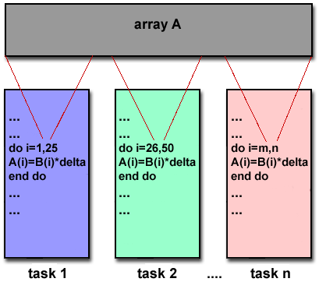
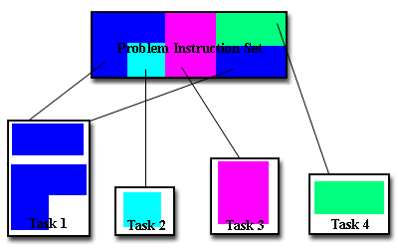
Patterns of Parallelism
Task: a piece of code (could be executed in a process or thread)

Slide 32
Parallelism in Software
Basic questions:
  what may be executed in parallel?
  what prevents parallel execution?
  what if only part of my program can be executed in parallel?
Then, how can the parallelization strategy be expressed using a programming API?

Slide 33
Ready for a short example?

Slide 34
Example: Conjugate Gradient
Powerful and widely used iterative method for solving large (sparse) systems of linear equations
Belongs to a class of iterative methods known as minimization methods

Slide 35
Conjugate Gradient
For a (symmetric positive definite) matrix A, the unique x that minimises the quadratic function
q(x) = (1/2) x^{T} Ax- x^{T}b
is the solution to the system Ax = b since the gradient of q(x) is Ax-b, which is zero when q(x) is minimum.
An iteration of a minimization method is of the form
        x_{k} = x_{k-1} + s_{k} d_{k}
where s_{k} is a scalar step size and is the d_{k} direction vector
An iterative approach

Slide 36

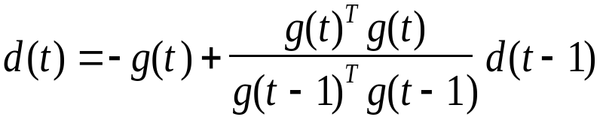
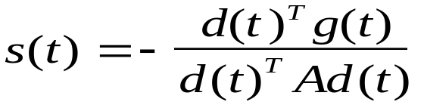

Algorithm: An Iteration of The Following Steps
Matrix-Vector Product
step 1: compute the gradient
step 2: compute the direction vector
Vector Inner Product
step 3: Compute the step size
Vector Inner Product
Matrix-Vector Product
step 4: Compute the new approximation of X

Slide 37
Where is The Parallelism?
Matrix vector product: Each element in result vector can be independently computed
Vector inner product : Each element in result vector can be independently computed
Independent → it can be done in parallel
Exactly how this is implemented depends on machine and programming model

Slide 38
OK, but what just do we mean when we say that statements can execute in parallel?

Slide 39
When Can Two Statements Execute in Parallel?
In a sequential (single-threaded) process:
    statement 1;
    statement 2;
With two threads:
  thread1: thread2:
    statement1; statement2;

Slide 40
Fundamental Assumption
Threads execute independently on their assigned resources: no control over order of execution of instructions between threads unless specified using special programming constructs

Slide 41
When Can Two Statements Execute in Parallel?
Possibility 1
  Thread1: Thread2:
    statement1;
    statement2;
Possibility 2
  Thread1: Thread2:
    statement2:
    statement1;

Slide 42
When Can Two Statements Execute in Parallel?
When their order of execution does not matter!
In other words,
    statement1; statement2;
    must be equivalent to
    statement2; statement1;

Slide 43
Example 1
    a = 1;
    b = 2;
Statements can be executed in parallel.

Slide 44
Example 2
    a = 1;
    b = a;
Statements cannot be executed in parallel
Of course, here we can rewrite this so that second instruction is:
    b = 1;
Some code rewriting is often necessary

Slide 45
Example 3
    a = f(x);
    b = a;
We could change this similarly, and execute the resulting statements in parallel
But is it worthwhile? If yes, we replicate computations
Replication reduces the observed speedup and introduces overheads, but can be useful.

Slide 46
Example 4
    b = a;
    a = 1;
Statements cannot be executed in parallel

Slide 47
Example 5
    a = 1;
    a = 2;
Statements cannot be executed in parallel

Slide 48
True Dependence
Statements S1, S2
S2 has a true dependence on S1
iff
S2 reads a value written by S1
S1: a = 1
S2: b = a

Slide 49
Anti-Dependence
Statements S1, S2.
S2 has an anti-dependence on S1
iff
S2 writes a value read by S1
S1: b = a
S2: a = 1

Slide 50
Output Dependence
Statements S1, S2.
S2 has an output dependence on S1
iff
S2 writes a variable written by S1
S1: a = 1
S2: a = 2

Slide 51
When Can 2 Statements Execute in Parallel?
S1 and S2 can execute in parallel
iff
there are no dependences between S1 and S2
  true dependences
  anti-dependences
  output dependences
Note: in each case at least one “write” is involved.
What does this mean if we have two instruction sequences?

Slide 52
When Can 2 Statements Execute in Parallel?
Some dependences can be removed
To parallelize code, determine dependences and remove as many as possible
Remaining dependences place limits on parallelism that can be achieved

Slide 53
Correctly identifying the dependences in a program code is one of the most important tasks for the application developer!

Slide 54
Summary So Far…
Term threads used to refer to both hardware resources and software entities
  We can usually ignore this and consider threads in application software
  However, when considering performance, we cannot ignore the mapping of software threads to the hardware
Application developer creates program with pieces of code that can execute concurrently
  Chooses granularity, may rewrite some code

